Slide 1
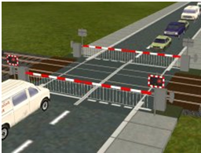
A minor Project Presentaion On Automated Railway Gate Control System
[ N.V.P.E.M.I KANPUR ]
Session: 2020-21
Submitted By-
Ajay kumar
B.Tech(ECE 4th year)
1742931001
Submitted To-
Prof.Ashish Nigam
HOD (ECE Dept.)

Slide 2
A minor Project Presentation On Automated Railway Gate Control System
[ N.V.P.E.M.I KANPUR ]
Session: 2020-21
Submitted By-
Ajay kumar
B.Tech(ECE 4th year)
1742931001
Submitted To-
Prof.Ashish Nigam
HOD (ECE Dept.)

Slide 3
Contents
Objective
Components
Circuit diagram
Software Used In Projects
Simulation
Working
Microcontroller PIC16F877A
L293D Motor Driver
Crystal oscillator
Servo motor

Slide 4
Objective
The objective of this project is to create an automatic railway gate control system which can be implemented easily in roads. Generally there are manual gate control system which are maintained by person.As vehicles are increasing day by day it has become more difficult to control the gate manually.As a result often accident occurs and many people become injured badly and sometimes it become very serious when people died due to this type of accidents.
This project can help us to reduce accidents in our country by introducing automatic railway gate control system

Slide 5
Components
❖ PIC16F877A Micro-controller
❖ Servo Motor
❖ Crystal oscillator
❖ L293D IC , Dual H-Bridge Motor Driver
❖ Resistances
❖ LM016L LCD Display
❖ Switch

Slide 6
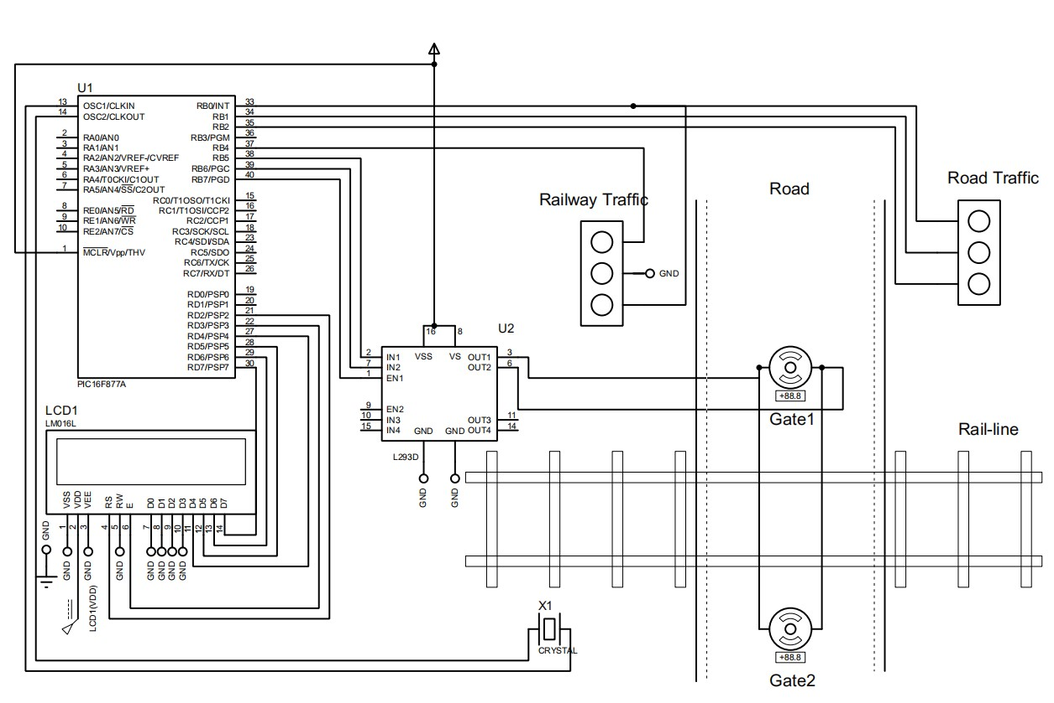
Circuit Diagram:-

Slide 7
Software Used In Projects
Proteus 8 Professional
Keil uVision or Microchip studio 7
Proteus 8 Professional
Proteus 8 Professional is a software which can be used to draw schematics, PCB layout, code and even simulate the schematic . You can simulate your work and be more efficient in completing the task at hand. It is developed by Lab center Electronic Ltd.
Keil µVision IDE
The µVision IDE combines project management, run-time environment, build facilities, source code editing, and program debugging in a single powerful environment. µVision is easy-to-use and accelerates your embedded software development. µVision supports multiple screens and allows you to create individual window layouts anywhere on the visual surface.

Slide 8
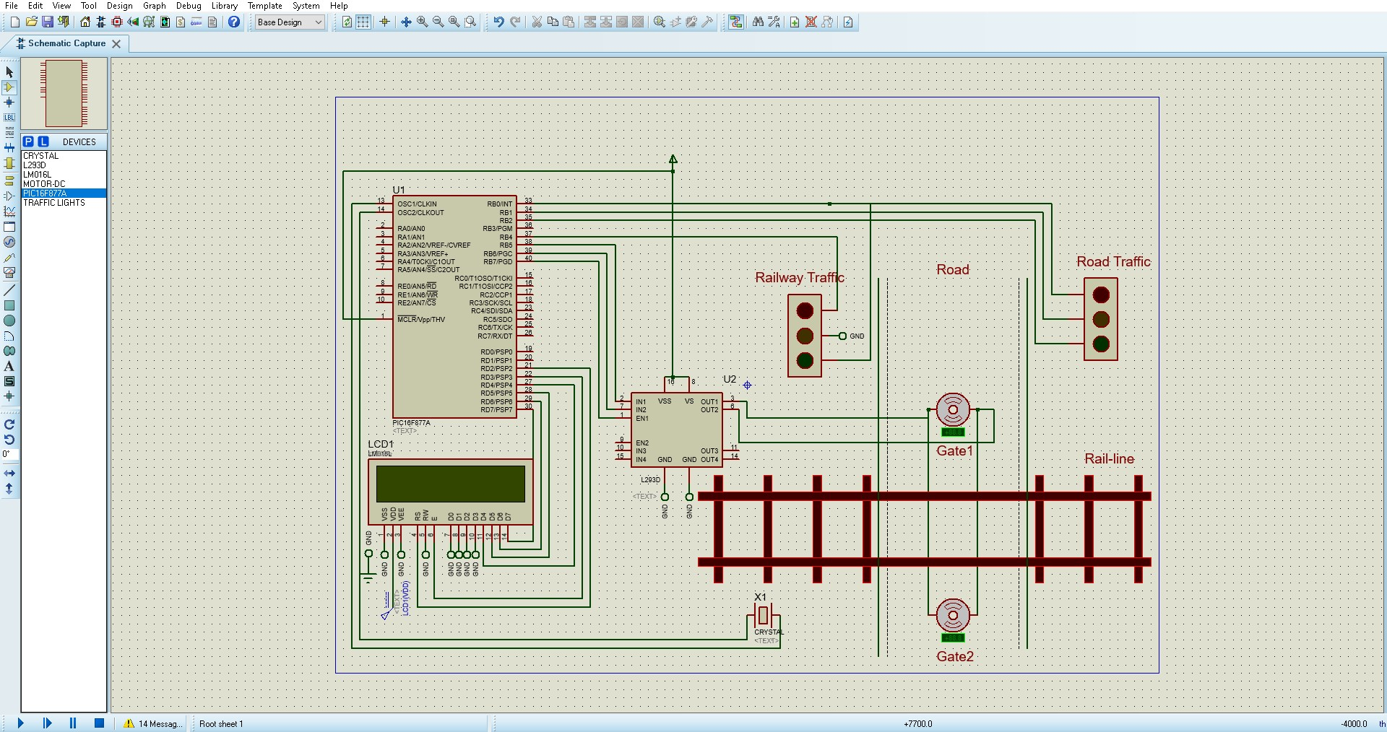
Before Simulation

Slide 9
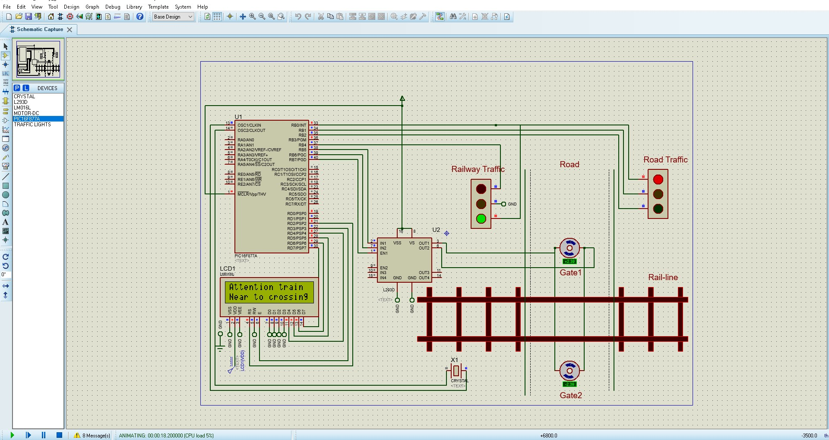
After Simulation

Slide 10
Working of automated railway gate control system
In this project to lift the railway crossing gate D.C. series motor. Gear arrangement is used. The Crystal oscillator at two points on away from railway crossing gate is used. A crystal oscillator is an electronic oscillator circuit that uses the mechanical resonance of a vibrating crystal of piezoelectric material to create an electrical signal with a constant frequency.This frequency is often used to keep track of time, as in quartz wristwatches, to provide a stable clock signal for digital integrated circuits. To send response on micro controller then micro controllerwhich received a data and complete the circuit when railway will pass through it and the gate will be closed and similarly when the rail will pass through the gate then after some delay open the gate . Hence the motor will operate and with help of gear, and the gate will open. In this way the automatic operation of gate takes place.

Slide 11
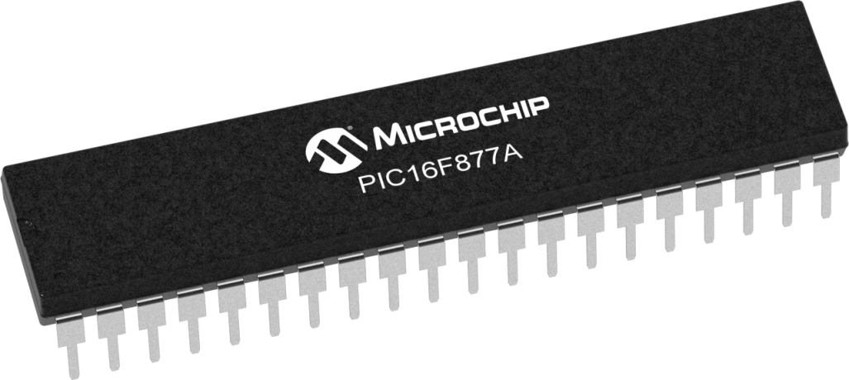
INTRODUCTION OF PIC16F877A microcontroller
The PIC microcontroller PIC16f877a is one of the most renowned microcontrollers in the industry. This microcontroller is very convenient to use, the coding or programming of this controller is also easier. One of the main advantages is that it can be write-erase as many times as possible because it uses FLASH memory technology. It has a total number of 40 pins and there are 33 pins for input and output. PIC16F877A is used in many pic microcontroller projects. PIC16F877A also have much application in digital electronics circuits. PIC16f877a It is used in remote sensors, security and safety devices, home automation and many industrial instruments. The cost of this controller is low and its handling is also easy. It is flexible and can be used in areas.

Slide 12
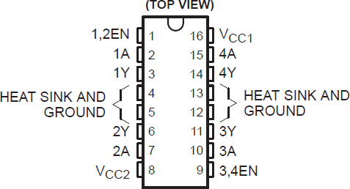
L293D Motor Driver Introduction
L293d IC is known as a motor driver. It is a low voltage operating device like other ICs. The other ICs could have the same functions like L293d but they cannot provide the high voltage to the motor. L293d provides the continuous bidirectional Direct Current to the Motor. The Polarity of current can change at any time without affecting the whole IC or any other device inthe circuit. L293d has an internal H-bridge installed for two motors.

Slide 13
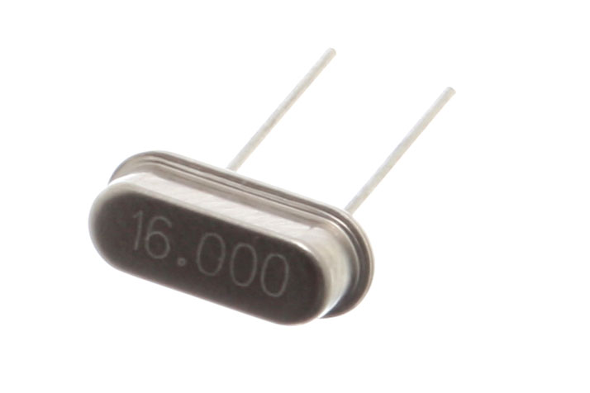
Crystal oscillator
A crystal oscillator is an electronic oscillator circuit that uses the mechanical resonance of a vibrating crystal of piezoelectric material to create an electrical signal with aconstant frequency. This frequency is often used to keep track of time, as in quartz wristwatches, to provide a stable clock signal for digital integrated circuits, and to stabilize frequencies for radio transmitters and receivers. The most common type of piezoelectric resonator used is the quartz crystal, so oscillator circuits incorporating them became known as crystal oscillators, but other piezoelectric materials including polycrystalline ceramics are used in similar circuits.

Slide 14
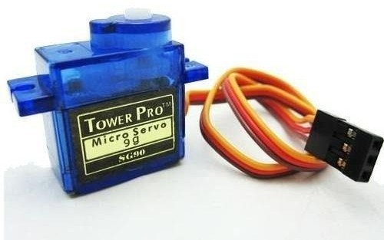
Servo Motor
Servomotor is a rotary actuator or linear actuator that allows for precise control of angular or linear position, velocity and acceleration. It consists of a suitable motor coupled to a sensor for position feedback. It also requires a relatively sophisticated controller, often a dedicated module designed specifically for use with servo motors. Servomotors are not a specific class motor although the term servomotor is often used to refer to a motor suitable for use in a closed-loop control system.

Slide 15
THANK YOU

